Slide 1
IMAGE GALLERY WITH AUTOMATED IMAGE TAGGING
By
Shashank Hegde (BT15CSE080)
Under the guidance of Dr. P.S Deshpande

Slide 2
INTRODUCTION

Slide 3
Problem Description
Input:
a. A query string of the form
1. “object”
2. “object relationship (For example; on/in) object”
b. Set of Images stored in an Image Gallery.
Output:
Set of images which have the content specified by the query.
For example; all images which have “apple” or “apple on table”.

Slide 4
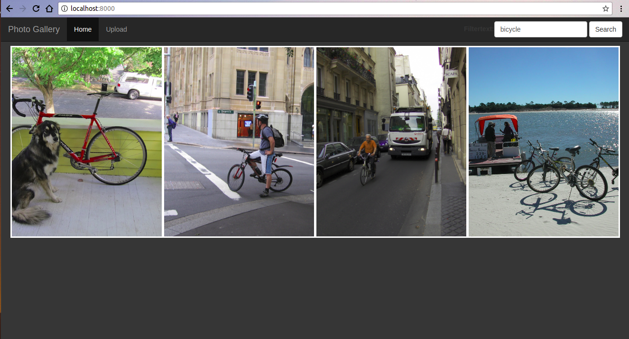
Query type 1 example : “bicycle”

Slide 5
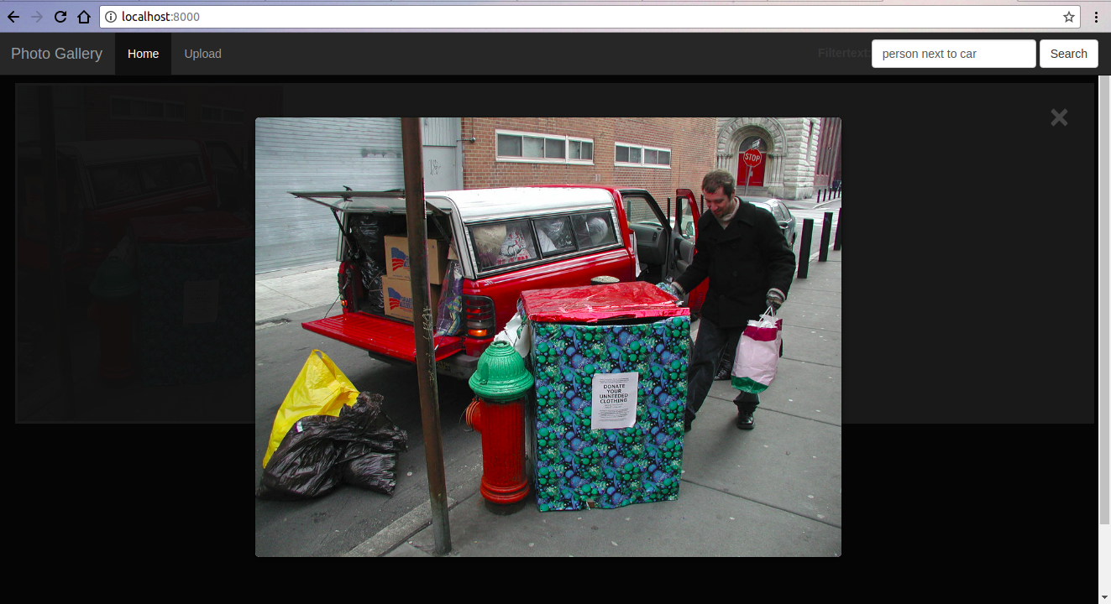
Query type 2 example : “person next to car”

Slide 6
Significance
In a database storing character type data, retrieving a data item done easily by text comparison.
Retrieving images is a non-trivial task because comparison with images is not well defined.
Image gallery is an application where storage and efficient retrieval of images is a required feature.

Slide 7
Significance
In an Image gallery, images should be retrievable by specifying their content.
Hence, queries describing objects and their relationships in the image are used in this problem.
Queries of type 2 are more important because:
Those are more specific as than object-only queries.
We tend to remember events and they can be described more accurately with these type of queries.

Slide 8
SYSTEM OVERVIEW

Slide 9
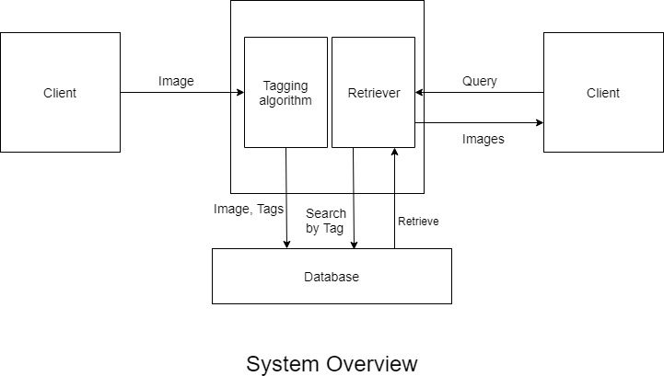

Slide 10
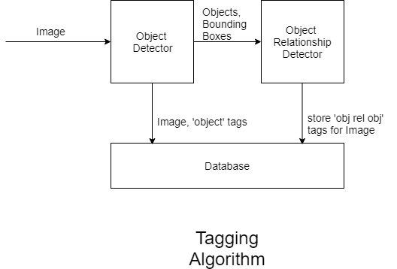

Slide 11
Algorithms
Object Detection: Darknet with YOLO v2 is used as object detector for the tagging algorithm. The model is pre-trained on COCO dataset with 80 labels.
Object Relationship Detection: The model used in the Object Agnostic Shuffle-Then-Assemble (STA) method is used. It was trained on VRD (Visual Relationship Dataset) dataset. The model identifies 70 relationship categories.

Slide 12
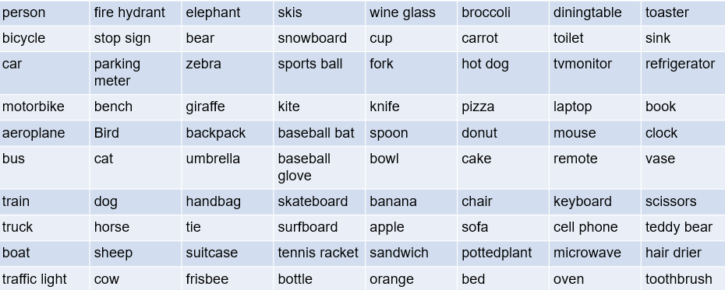
Object Classes for Query type 1

Slide 13
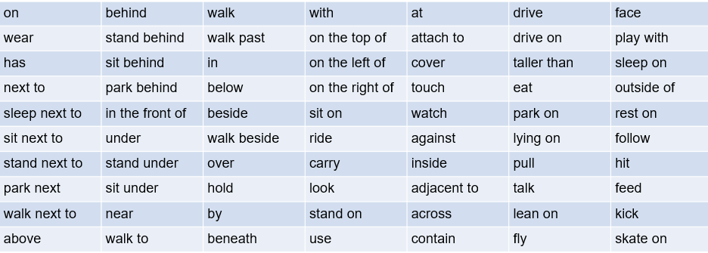
Relationship categories for Query type 2

Slide 14
CHALLENGES

Slide 15
Challenges
Determining which object bounding boxes predicted by the Object Detection part are to be used for the object relationship detection part.
Determining pairs of bounding boxes, predicted by the Object Detection part, to be passed as input to the object relationship detection part.
Removing False Positives and Impossible object relationship combinations from the predictions by object relationship detection part.

Slide 16
CONTRIBUTIONS

Slide 17
CONTRIBUTIONS
Determining which object Bounding Boxes to send: A threshold of 0.50 was set for confidence values. Bounding boxes of object predictions with confidence > threshold are sent to the object relationship detection part.
Determining pairs of bounding boxes input to the object relationship part: All possible combinations of the filtered objects (their bounding boxes) are passed to the object relationship detection part.

Slide 18
RESULTS

Slide 19
Results
The Application supports query type 1 i.e Object Detection with an mAP of 48.1 for an IoU of 0.5. This is the accuracy of the Object Detection part.
The Recall@100% as well as Recall@50% is 46.68 % for the VRD testing set of 500 images. The values have been recorded to be 46.48% when evaluated on a testing set of 1000 images.

Slide 20
CONCLUSION

Slide 21
Conclusion
An image gallery web application which supports features like upload image, view images and query and retrieve images has been developed. Types of queries: a) “object” and b)”object relationship object” for image retrieval.
The object detection part makes use of the YOLO method while the object relationship detection part make use of the Object-Agnostic Shuffle-Then-Assemble method. Both are state-of-the-art methods for their respective tasks.
Future Scope:
On the user level, few features like options to delete images could be added.
Also, the process of uploading an image is slow (because of the tagging process that happens during upload). This could be improved for better user experience.
We could devise a completely new object detection model which is faster and also more accurate.
Mainly, improvements need to be made to the object relationship detection part. One suggestion is to make a set of impossible combinations so as to eliminate a prediction which falls in this set.
We must remove false positives.
We could devise a new model on our own which is faster and more accurate.

Slide 22
THANK YOU !

